Slide 1
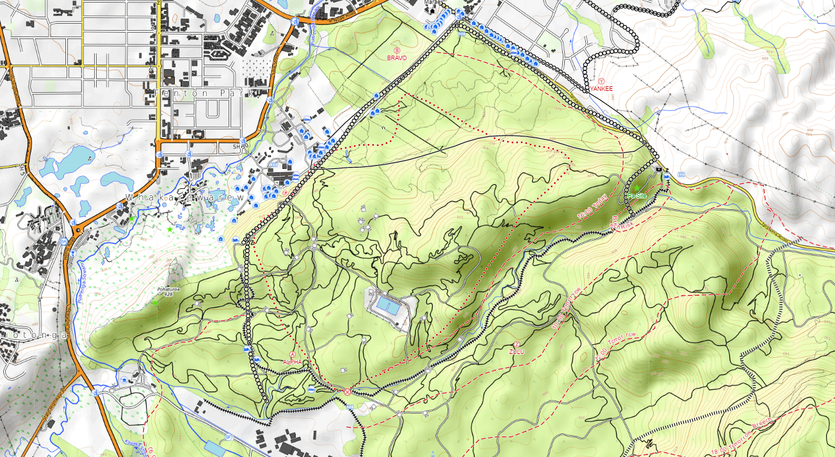

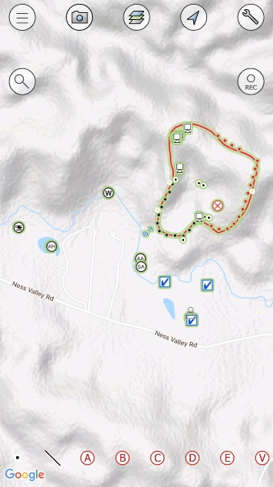
Introduction to firemapper Enterprise
Mobile app, portal and access control
Notes:
Credit to: David Herries and Jamie Cowan and Tim Mitchell for getting FireMapper approved as a FENZ tool

Slide 2

Prestation outline.
Why FireMapper Enterprise?
What is FireMapper Enterprise?
What access is available to who?
Recommended approach to use of FireMapper Enterprise
Using the mobile application
Using the portal
Training follow-up and assistance
Notes:
Apologies for death by screen shots.
Jokes
Most of this is easy but we need it to be familiar to be able to be used under pressure.
Presentation is a work in progress.

Slide 3

Why FireMapper ?
Needs assessment identified a good wildfire mapping system should include:
Offline functionality
Easily add fireground features
Linking between devices to generate a ‘Live Map”
Aid tracking of resources
Share information with other systems.
Import and export spatial information.
FireMapper’s functionality stood out against other options when measured against the needs assessment.
Notes:
This is emphasised so people understand why we are not using other systems such as Survey 123 and ARC like USAR do?”

Slide 4
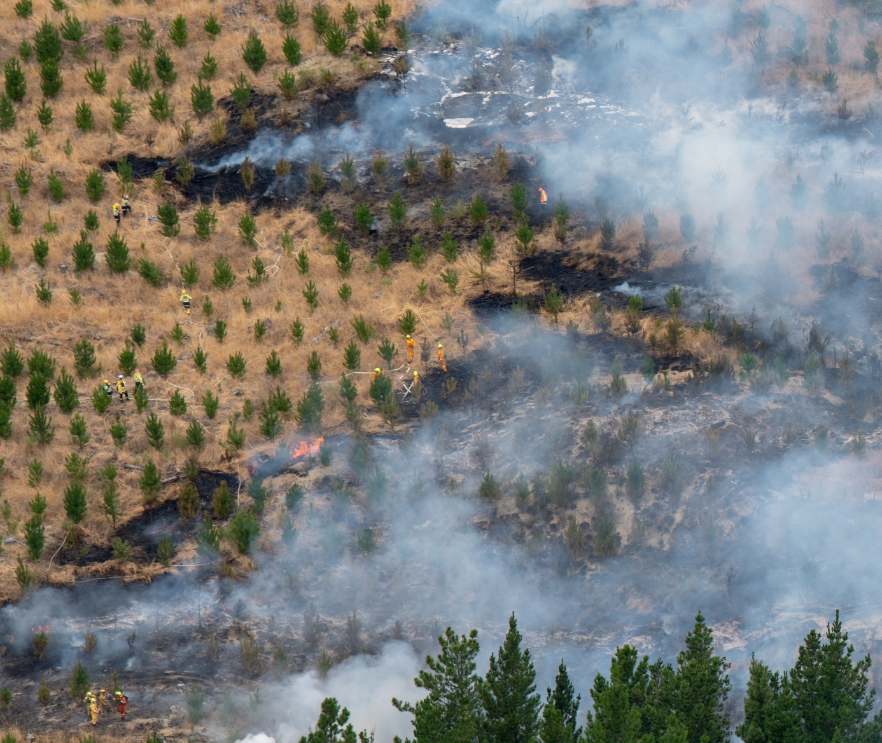
What access is available to who?
  18 Administrators (can issue access). One person per district as listed on the portal page.
  100 Licences for Executive Officers who respond to and manage Veg fire Initial attack and a selection of others who work at a similar level such as external Air Attack Supervisors
  20 Shared Licences – can be issued to somebody for up to 14 days.
  Portal Access - Coordination Centres and Command Units
  Tokens for temporary portal access can be issued as required.
  Access will be reviewed after year one
Notes:
Need to know the other “administrators” in your region in case your person is away.
Why have we not given access to the masses.

Slide 5







What is Fire Mapper Enterprise and how does it work?
Front line
Key
Points and line data
Base Layer tiles (images)
Location tracking (
Mobile device tracking
Other GIS data
Supporting resources
IMT / RCC
ALPS
Archaeological points
Lifeline services
Incident data
Arena aircraft locations
Stakeholder land parcels
FENZ GIS
Internet data eg. Traffic / roadwork information
Notes:
Integration will not be available initially.
Integration will need to be carefully planned so we do not clutter the maps.

Slide 6
Fire ground
IMT
NCC / RCC
Exec Officer receives call, searches location and assesses with fire mapper recognises fire is likely to escalate
Exec Officer arrives & becomes IA-IC of escalating fire - changes map to “shared” and adds basic features incl sectorisation during recon flight.
IA-IC arranges licences for Sector Supervisors Requests IMT
IMT Gains access to map for management of the incident, and also orders a mapping specialist
Coordination centres obtain basic situational awareness of escalating incident and provide managers, media team, etc outline of situation.
Intelligence Unit monitors map input quality. While mapping specialist uses fire mapper to monitor current situation and uses other tools for analysis of impacts and likely incident development.
Operations Mgr, Air Operations and Sector Supervisors keep the fireground map up to date
PIM / Liaison able to produce maps for Public and share live maps where appropriate
Mapping specialist adds features from other sources, such as thermal flights and forestry data
Operations, use detailed, live maps to plan and implement tactics of the response

Slide 7
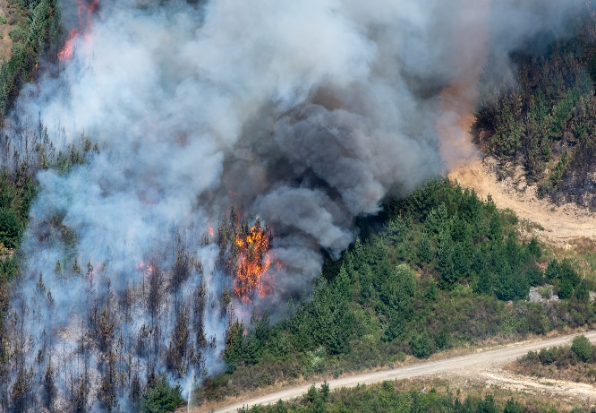
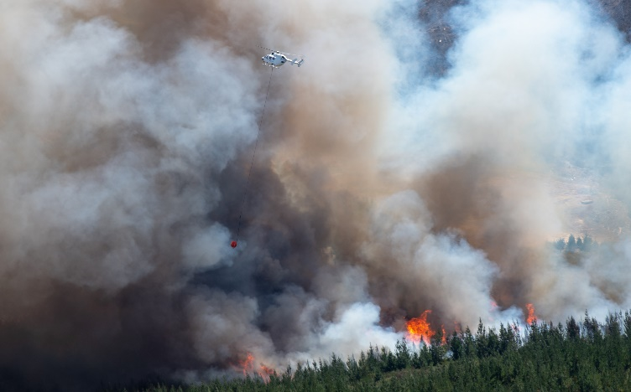
Using the mobile application
  This section will cover:
  Supported devices
  Accessing User Profile, symbology and User Manual
  Creating/deleting private and shared maps
  Adding, adjusting point and line features.
Notes:
Raise your hand if you know everything on a page.
Use the comments section if you have questions or comments.

Slide 8
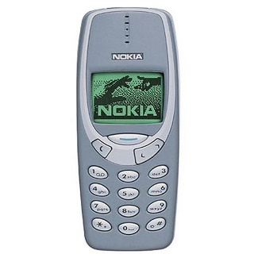

Supported Devices
X
Android 9 or newer (Generally devices 4 years old or newer)
iOS 12 or higher. But not “WIFI only iPads”
Correct time on device
Up to date app version.
√

Slide 9

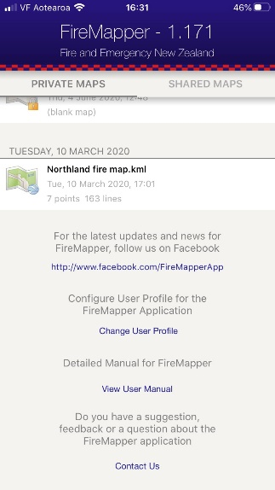
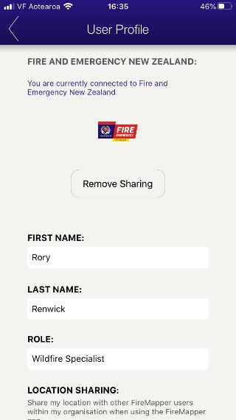
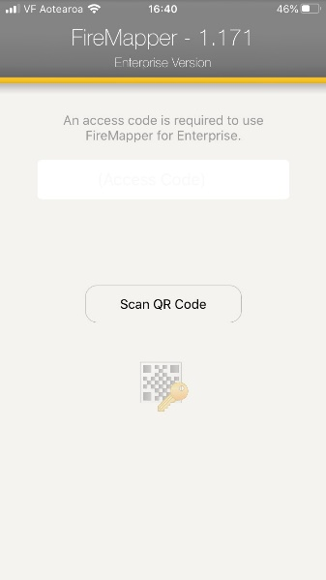
Setup – connect to FENZ Maps
Complete the actions as described in the following slides to get familiar with the App.
1 2 3
Select change user profile
Scan the code above.
Select change user profile
NB; you will jump straight to this screen if the app does not have an access code.
Note the location of the user manual

Slide 10
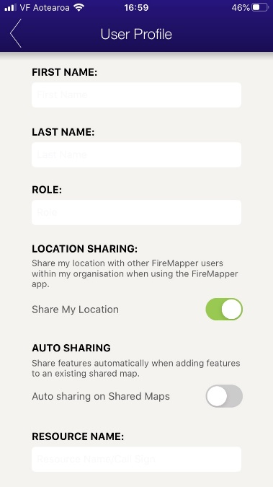
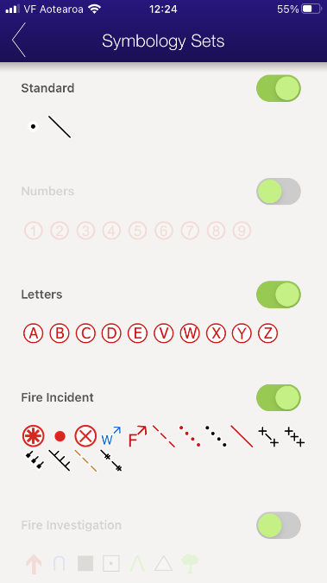
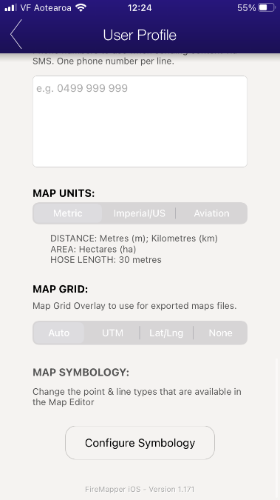
Return to “Change User Profile” and add details.
Share my location allows other on the incident to see where you are.
Auto sharing (iOS only) means features you add will automatically shared – or you can select which features you want to share.
At the bottom you select Configure Symbology.
Notes:
WARNING DO NOT RELY ON SHARING. Helpful Not dependable feature. It is not an EPIRB

Slide 11
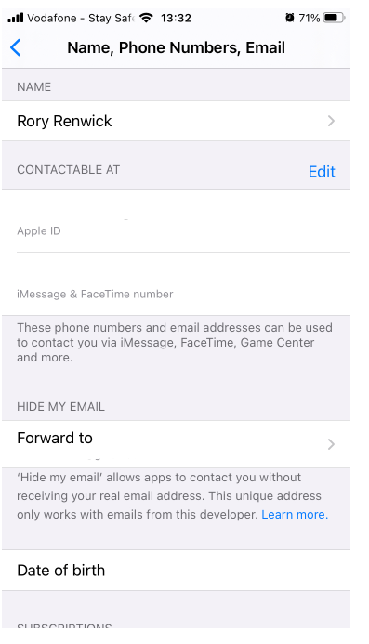
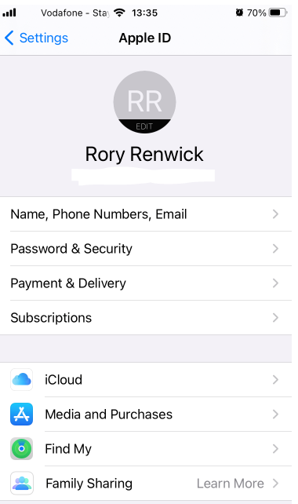
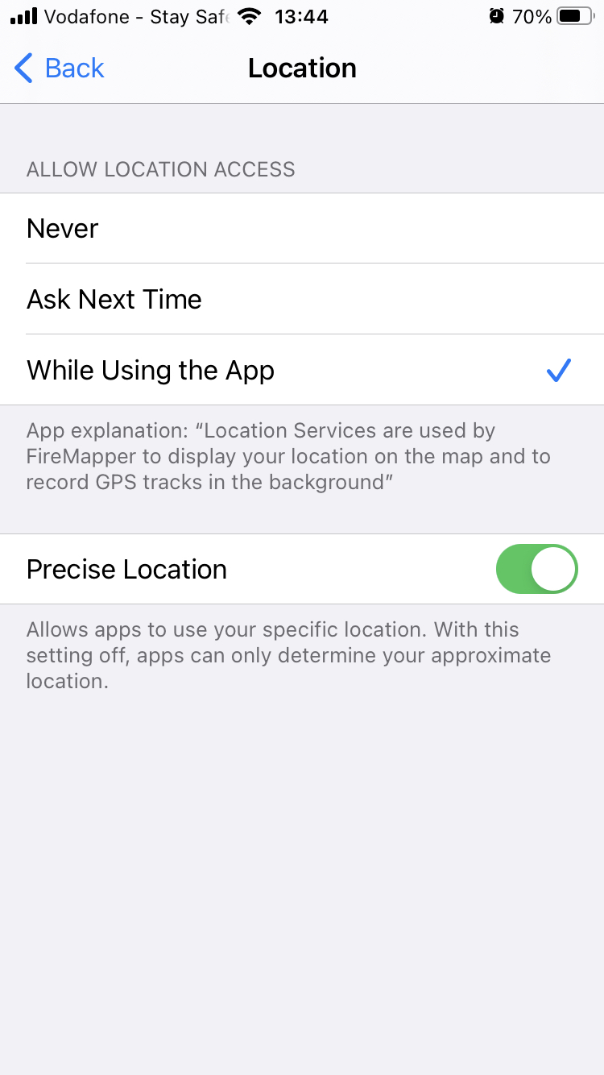
Setting up User Profile
Return to “Change User Profile” and add details.
Share my location allows other on the incident to see where you are but only while using the app and provided you have entered your name in the user profile
Auto sharing means features you add will automatically shared – or you can select which features you want to share.
At the bottom of “user profile” you select Configure Symbology.
Go to device settings and ensure that your device is named appropriately as this is attached to all features you add
Also go to the location settings and make sure that FireMapper has permission to use your current location and high accuracy or is turned on.
Notes:
WARNING DO NOT RELY ON SHARING. Helpful Not dependable feature. It is not an EPIRB

Slide 12
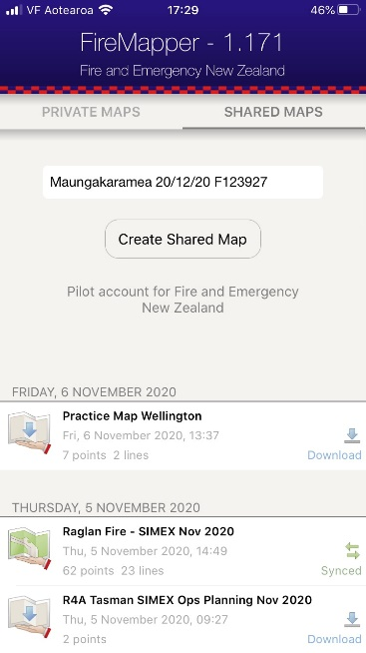
Create a New Map
Select “Private Maps” or “Shared Maps”
Recommended format:
    Location date F# eg.
    Maungamuka 20/12/20 F3213927

Slide 13

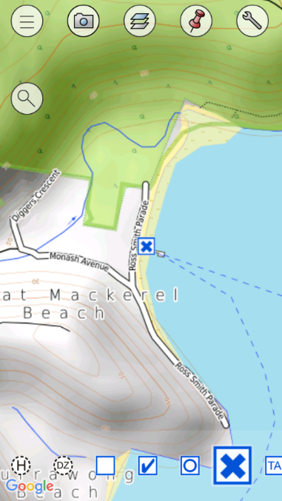






Map View Overview
Main Menu – Return to the main menu and map lists
GPS Camera – Capture a photo and records its location
Map Base Layer – Change to the next available map layer
Mark Location – Mark the current location with the selected point type
Search Location – Find a location by address, grid reference, coordinates.
Map Options – View additional map options and/or Export the current map.

Slide 14

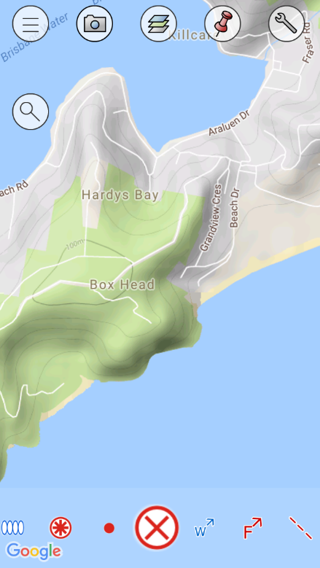


Add Points
Tap and hold your finger on the location you want to add the point
Drag your finger left and right on the bottom toolbar to view available point types
Tap a point type on the bottom toolbar to select

Slide 15
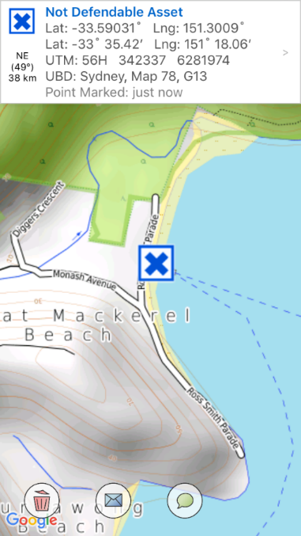
Map View (Different Modes)
Feature Mode
FEATURE IS SELECTED
Map Mode
NO FEATURE SELECTED
Feature Popup View
Summary of the Selected Feature
Map Toolbar
List of map options and tools for adding new features
Feature Toolbar
List of available options for the selected feature
Feature Types
Used to add new features to the map

Slide 16










Send As Email - Send the selected feature as a Email
Feature controls
Send As Text - Send the selected feature as a Text Message
Rotate - Rotate the selected point (e.g. Fire Direction, Wind Direction, etc.)
Flip - Flip the selected line (e.g. Back burn)
Downgrade - Change to Proposed Status (e.g. → Proposed Back burn)
Upgrade - Change to Completed Status (e.g. → Completed Back burn)
Delete - Delete the selected feature
Directions - Sends location to mapping apps to help you navigate to it.
Share – makes this feature visible to others looking at the same shared map. Sends location to mapping apps to help you navigate to it.

Slide 17

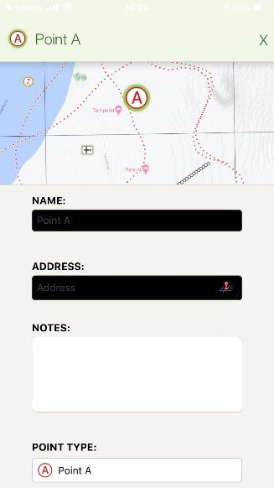
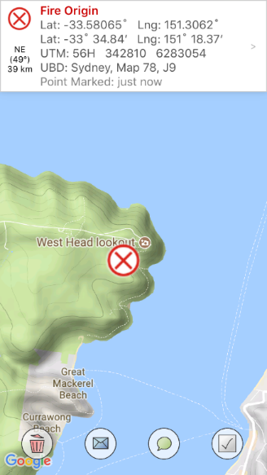

Feature Detail View
Click the Popup View to open the feature details view
Scroll through to see the list of details available for a feature
Change the Symbol
Notes:
Change Symbol type

Slide 18
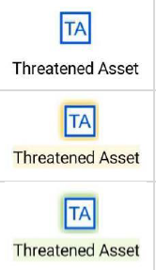
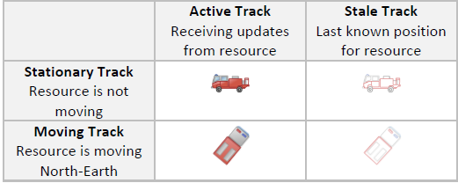
Interpreting feature icons.
Not Shared
Share Pending
Shared Successfully

Slide 19
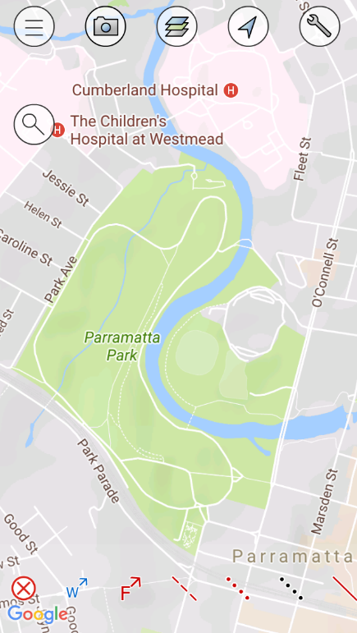
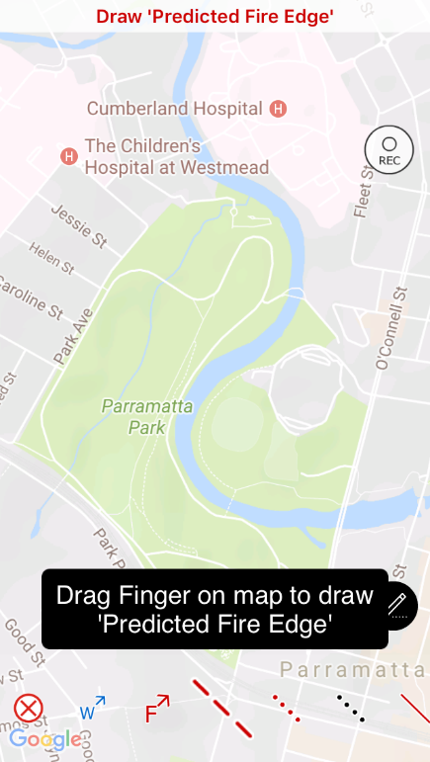
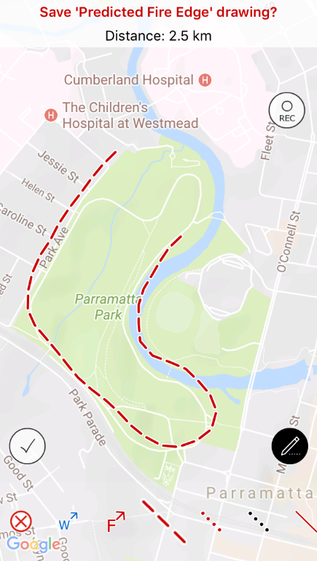
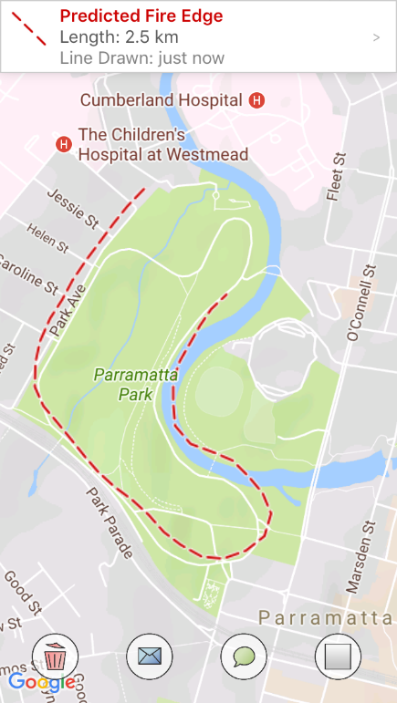
Drawing Lines
Drag your finger on the map to draw a line
Click the Save icon to save your changes
Select the line type you want to use for drawing
Notes:
Draw many short lines.

Slide 20



Recording Tracks
As previous select line feature
Press record as you start traveling the track then again at the end.
Recommend a few short lines rather than one long one in case situation changes
Points can be added while tracking lines.
Notes:
Switch between going and con

Slide 21
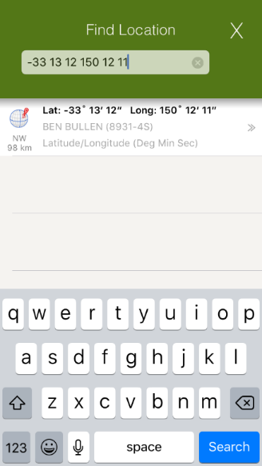
Location Search (great for initial assessment at time of turnout)
Search Location by:
Street Address
4 Figure Reference (e.g. 1234, 12-34)
6 Figure Reference (e.g. 123456, 123-456)
14 Figure Reference
UTM Reference
Latitude/Longitude
Decimal Degrees (e.g. -33.23 150.00)
Degrees Minutes (e.g. -33 12.22 150 44.3)
Degrees Minutes Seconds (e.g. -33 12 12 150 32 22)
… and more
(see user manual for examples)
Notes:
Searching and viewing an area will cache base layer information that has been viewed.

Slide 22
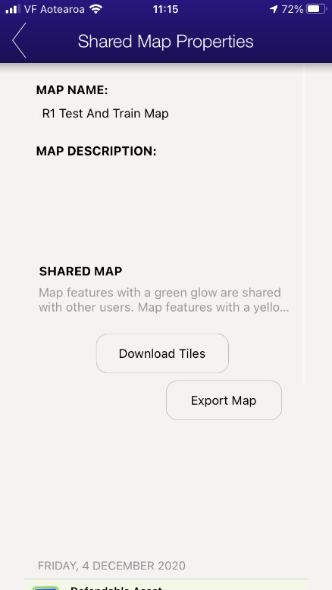
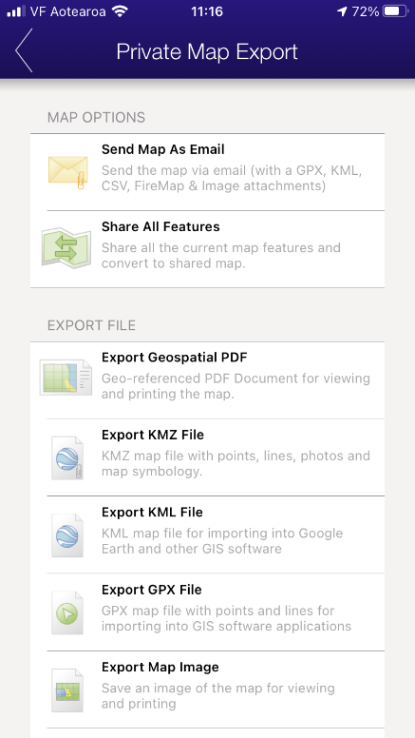
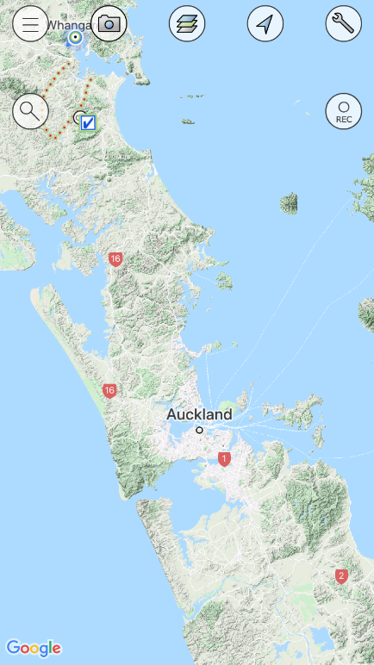
Export Maps
Select the spanner
Select Export Map
Select from options available
  First option is a mix of various files.
  Share all features will share features you have added to shared map
  GeoDPF e.g. for avenza however portal is better as it gives zoom control
  KMZ and KML are google shape files (KMZ includes photos etc).
  GPX is for adding data to a GPS.
  Map image is Export map image jpg for adding to reports etc.
  Other.
Notes:
Data File Managment

Slide 23

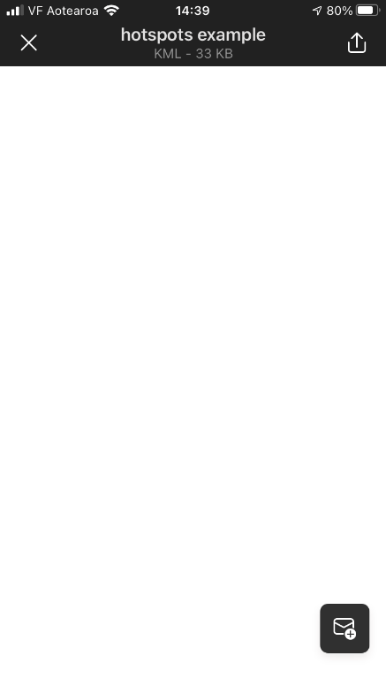
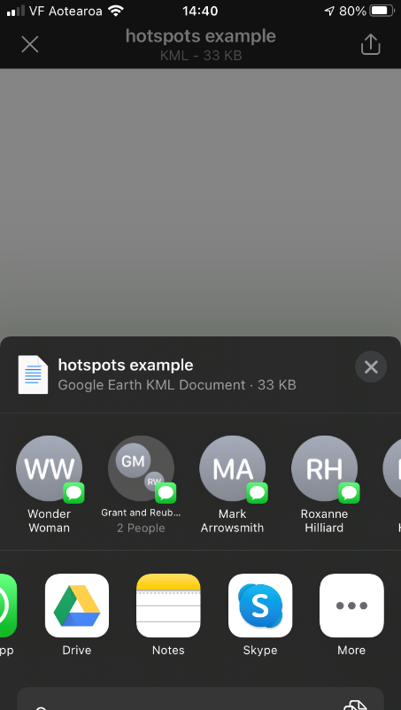
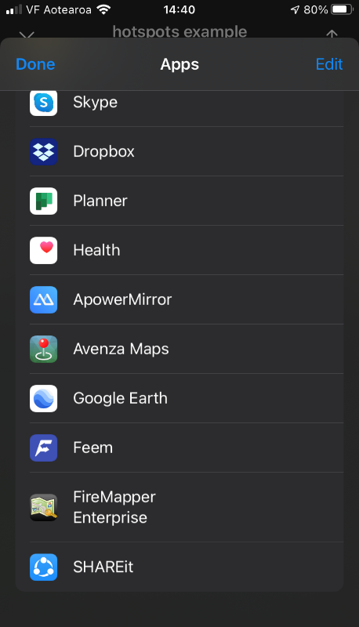
Importing information into the app
Compatible file types;
  KMZ, KML
  GeoDPF (iOS available now, in development for android)
Device dependent but usually - Select file from the source e.g. in email or on device storage
Find file on the device then “Share to” or “Open with” FireMapper Enterprise
Note this will be bought into a new private map, shape files will show as features and GeoPDF will be as an additional layer.
Notes:
Work in progress
Allows device to device sharing.

Slide 24
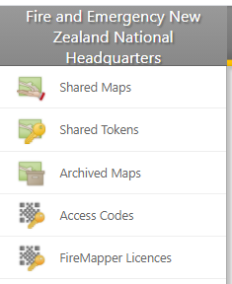
Using the portal https://portal.firefront.com.au/
Use Chrome or Microsoft Edge – Internet explorer may not have full functionality
Available current maps
Existing Tokens issued to share incident map
Archived Maps (removed from list on devices)
NOT IN USE
List of devices accessing our maps

Slide 25
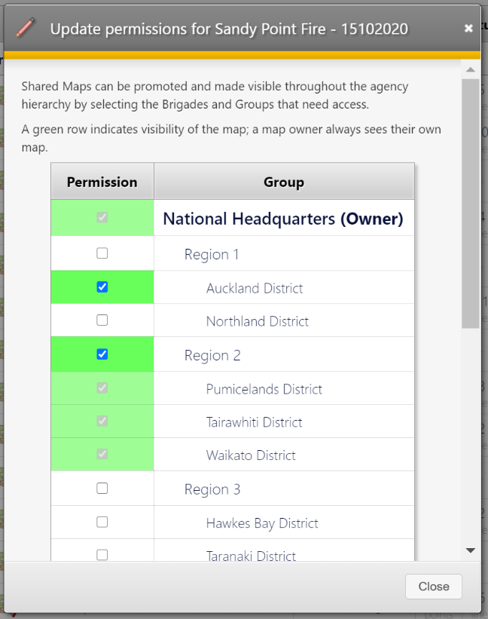
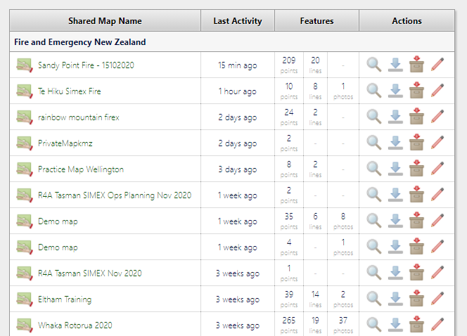
Sharing a map outside your district
Notes:
The default will be that a map will be shared with the people from the same district as the creator. If it needs to be shared with other people outside the district select the pencil next the relevant map and activate for the relevant districts.

Slide 26
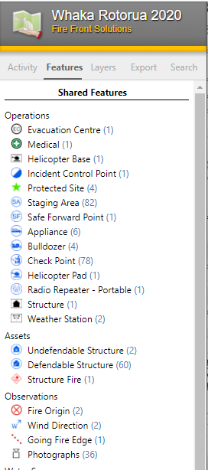
Viewing maps
Recommended for ICP, ICU, RCC and stakeholder viewing:
  Activity – Allows Navigation to recently added features
  Features - allows feature types to be turned off to manage map clutter on screen and exported maps
  Layers - change depending on map extent and include some near real time satellite imagery at wide extents.
  Export - options similar to the app - NB: Use the print preview allows edition of the Title, Key etc.
Notes:
Activities:
Turning off features to remove clutter
Export a PDF and edit titles etc – note that features turned off will not be showing.

Slide 27
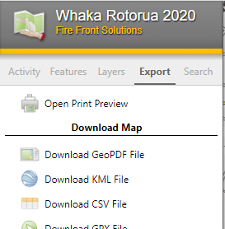
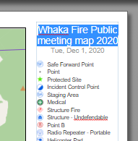


Custom map generation
Select “Open Print Preview”
Edit Map Titles and Key
Adjust map settings
  Map size
  Grid system
  Base layer
Adjust View
  Zoom
  Turn grids on/off
  Base Layer
Notes:
Custom maps can be useful when a printed map is required or it could be used to share information with the public.

Slide 28
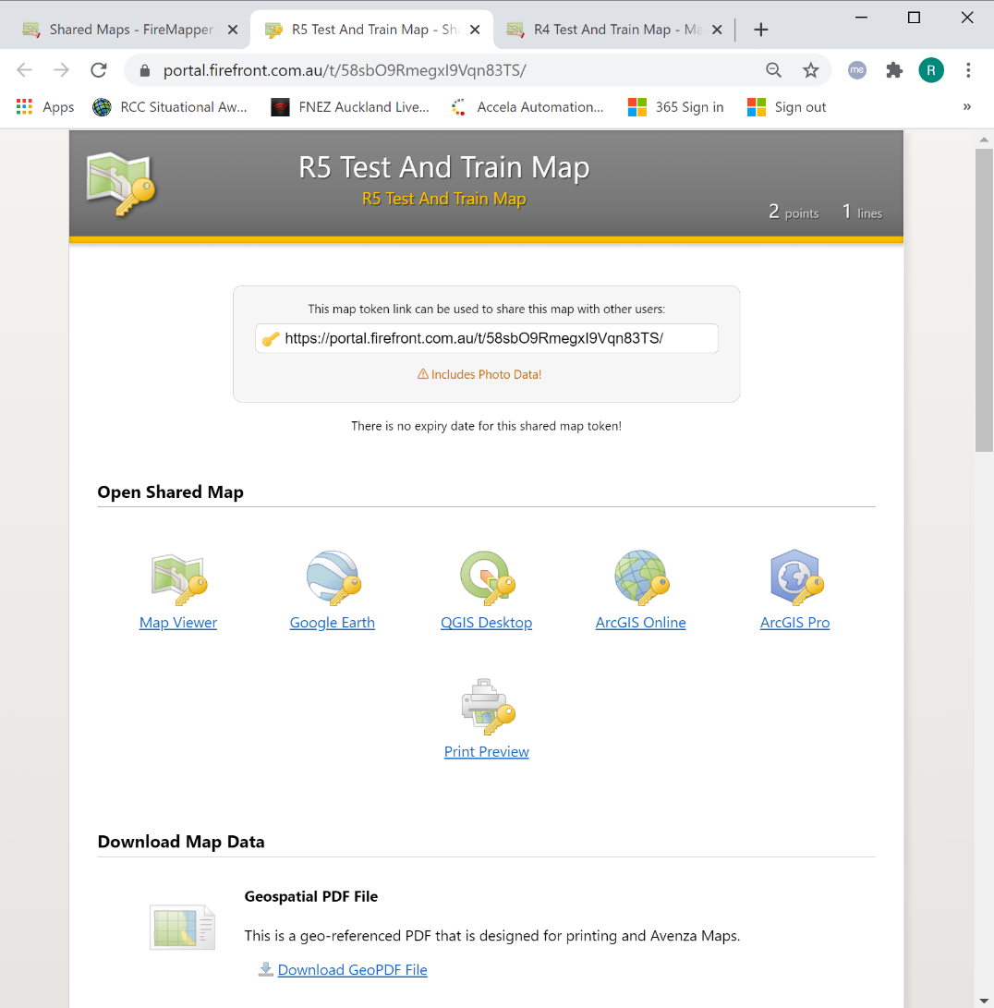
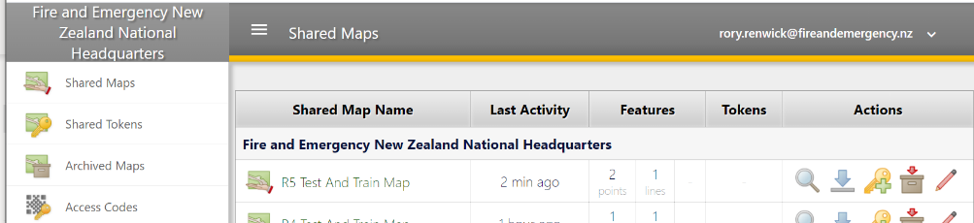

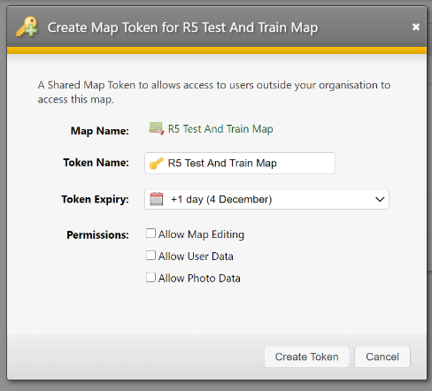
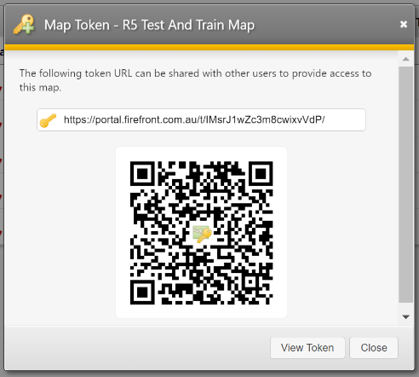
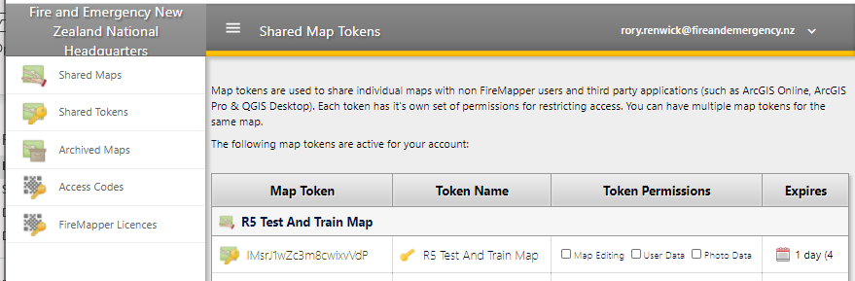
Issuing tokens for temporary portal access
Select shared maps
Select access key
Create the token
Copy and share the link or QR.
Recipient will now have a range of ways to access the map. Including FireMapper Portal
Select Shared Tokens to manage existing access
Notes:
Warning Allow Map Editing functionality is currently limited and ICT have instructed that this should only be used in exceptional circumstance.
Caution about access to: Photo data and user data.

Slide 29
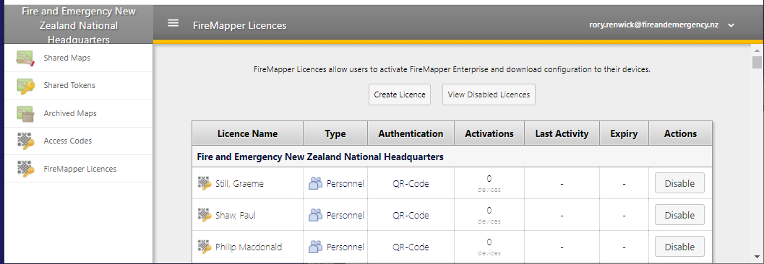
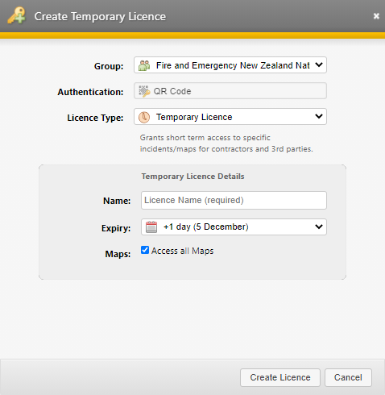
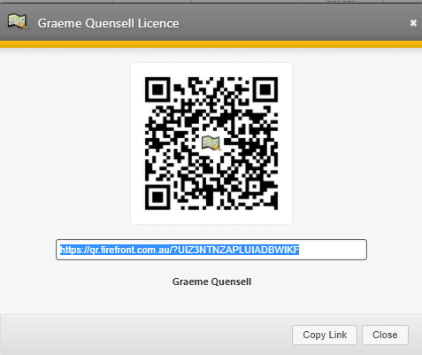
Allocating Licences
Select “FireMapper Licences”
Select “Create Licence”
Add name and duration and map availability
Share QR code or link with person
Notes:
Request was to allow all Execs to be able to issue temporary licences.
Should be read “only option”.

Slide 30
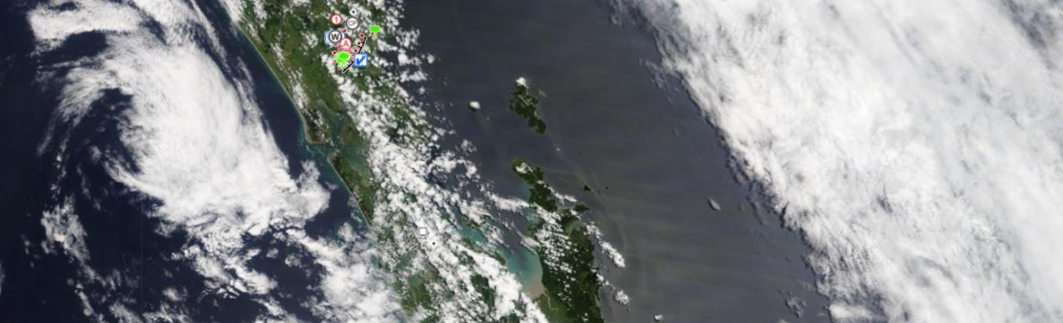
Support and feedback
FENZ Portal Page under “tools and applications / Response Capability”
District / Regional Administrators listed on the FENZ Portal
National Administrators – Wildfire and GIS Team.
FireFront solutions (Via National Admin)

