Slide 1
Introduction to firemapper Enterprise
Portal Access

Slide 2
Why FireMapper Enterprise?
Needs assessment identified a good wildfire mapping system should include:
Offline functionality
Easily add fireground features
Linking between devices to generate a ‘Live Map”
Aid tracking of resources
Share information with other systems.
Import and export spatial information.
FireMapper Enterprise's functionality stood out against other options when measured against the needs assessment.

Slide 3
What is Fire Mapper Enterprise and how does it work?
Front line
Key
Points and line data
Base Layer tiles (images)
Location tracking (
Mobile device tracking
Other GIS data
Supporting resources
IMT / RCC
ALPS
Archaeological points
Lifeline services
Incident data
Arena aircraft locations
Stakeholder land parcels
FENZ GIS
Internet data eg. Traffic / roadwork information
Notes:
Integration will not be available initially.
Integration will need to be carefully planned so we do not clutter the maps.

Slide 4
What access is available to who?
18 Administrators (can issue access). One person per district as listed on the portal page.
100 Licences for Executive Officers who respond to and manage Veg fire Initial attack and a selection of others who work at a similar level such as external Air Attack Supervisors
20 Shared Licences – can be issued to somebody for up to 14 days.
Portal Access - Coordination Centres and Command Units
Tokens for temporary portal access can be issued as required.
Access will be reviewed after year one.
Notes:
ed to know the other “administrators” in your region in case your person is away.
Why have we not given access to the masses.

Slide 5
Fire ground
IMT
NCC / RCC
Exec Officer receives call, searches location and assesses with fire mapper recognises fire is likely to escalate
Exec Officer arrives & becomes IA-IC of escalating fire - changes map to “shared” and adds basic features incl sectorisation during recon flight.
IA-IC arranges licences for Sector Supervisors Requests IMT
IMT Gains access to map for management of the incident, and also orders a mapping specialist

Slide 6
Fire ground
IMT
NCC / RCC
Exec Officer receives call, searches location and assesses with fire mapper recognises fire is likely to escalate
Exec Officer arrives & in this case becomes IA-IC of escalating fire - changes map to “shared” and adds basic features incl sectorisation during recon flight.
IA-IC arranges licences for Sector Supervisors Requests IMT
IMT Gains access to map for management of the incident, and also orders a mapping specialist
Coordination centres obtain basic situational awareness of escalating incident and provide managers, media team, etc outline of situation.
Intelligence Unit monitors map input quality. While mapping specialist uses fire mapper to monitor current situation and uses other tools for analysis of impacts and likely incident development.
Operations Mgr, Air Operations and Sector Supervisors keep the fireground map up to date
PIM / Liaison able to produce maps for Public and share live maps where appropriate
Mapping specialist adds features from other sources, such as thermal flights and forestry data
Operations, use detailed, live maps to plan and implement tactics of the response

Slide 7
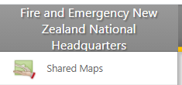
Using the portal https://portal.firefront.com.au/
Use Chrome or Microsoft Edge – Internet explorer may not have full functionality
Available current maps
Archived Maps (removed from list on devices)
For personal, coordination centre and ICU email accounts that have been issued FireMapper portal access go to https://portal.firefront.com.au/ and use the forgotten password process to get started.

Slide 8
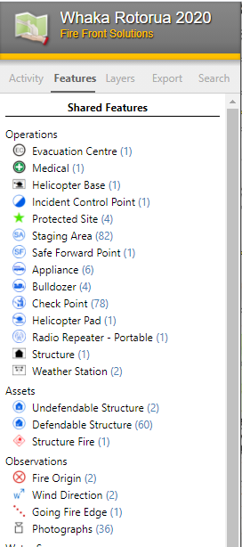
Viewing maps
Recommended for ICP, ICU, RCC and stakeholder viewing:
Activity – Allows Navigation to recently added features
Features - allows feature types to be turned off to manage map clutter on screen and exported maps
Layers - change depending on map extent and include some near real time satellite imagery at wide extents.
Export - options similar to the app - NB: Use the print preview allows edition of the Title, Key etc.
Notes:
Activities:
Turning off features to remove clutter
Export a PDF and edit titles etc – note that features turned off will not be showing.

Slide 9
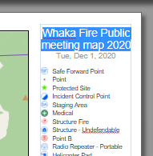
Custom map generation
Select “Open Print Preview”
Edit Map Titles and Key
Adjust map settings
Map size
Grid system
Base layer
Adjust View
Zoom
Turn grids on/off
Base Layer

Slide 10
Support and assistance
Quick reference guides on FENZ Portal Page under “tools and applications / Response Capability”
District / Regional Administrators listed on the FENZ Portal
National Administrators – Wildfire and GIS Team.
FireFront solutions (Via National Admin)

